Slide 1
Restricting and Sorting Data

Slide 2
Objectives
After completing this lesson, you should be able to do the following:
  Limit the rows that are retrieved by a query
  Sort the rows that are retrieved by a query
  Use ampersand substitution in SQL Developer to restrict and sort output at run time

Slide 3


Limiting Rows Using a Selection
EMPLOYEES
…
“retrieve all
employees in department 90”

Slide 4
Limiting the Rows That Are Selected
  Restrict the rows that are returned by using the WHERE clause:
  The WHERE clause follows the FROM clause.
SELECT *|{[DISTINCT] column|expression [alias],...}
FROM table
[WHERE condition(s)];

Slide 5

Using the WHERE Clause
SELECT employee_id, last_name, job_id, department_id
FROM employees
WHERE department_id = 90 ;

Slide 6
Character Strings and Dates
  Character strings and date values are enclosed by single quotation marks.
  Character values are case-sensitive, and date values are format-sensitive.
  The default date format is DD-MON-RR.
SELECT last_name, job_id, department_id
FROM employees
WHERE last_name = 'Whalen' ;

Slide 7
Comparison Conditions
Operator | Meaning
= | Equal to
> | Greater than
>= | Greater than or equal to
< | Less than
<= | Less than or equal to
<> | Not equal to
BETWEEN ...AND... | Between two values (inclusive)
IN(set) | Match any of a list of values
LIKE | Match a character pattern
IS NULL | Is a null value

Slide 8

Using Comparison Conditions
SELECT last_name, salary
FROM employees
WHERE salary <= 3000 ;

Slide 9

Using the BETWEEN Condition
Use the BETWEEN condition to display rows based on a range of values:
SELECT last_name, salary
FROM employees
WHERE salary BETWEEN 2500 AND 3500 ;
Lower limit
Upper limit

Slide 10

Using the IN Condition
Use the IN membership condition to test for values in a list:
SELECT employee_id, last_name, salary, manager_id
FROM employees
WHERE manager_id IN (100, 101, 201) ;

Slide 11
Using the LIKE Condition
  Use the LIKE condition to perform wildcard searches of valid search string values.
  Search conditions can contain either literal characters or numbers:
    % denotes zero or many characters.
    _ denotes one character.
SELECT first_name
FROM employees
WHERE first_name LIKE 'S%' ;

Slide 12

Using the LIKE Condition
  You can combine pattern-matching characters:
  You can use the ESCAPE identifier to search for the actual % and _ symbols.
SELECT last_name
FROM employees
WHERE last_name LIKE '_o%' ;

Slide 13
Using the NULL Conditions
Test for nulls with the IS NULL operator.
SELECT last_name, manager_id
FROM employees
WHERE manager_id IS NULL ;

Slide 14
Logical Conditions
Operator | Meaning
AND | Returns TRUE if both component conditions are true
OR | Returns TRUE if either component condition is true
NOT | Returns TRUE if the following condition is false

Slide 15

Using the AND Operator
AND requires both conditions to be true:
SELECT employee_id, last_name, job_id, salary
FROM employees
WHERE salary >=10000
AND job_id LIKE '%MAN%' ;

Slide 16

Using the OR Operator
  OR requires either condition to be true:
SELECT employee_id, last_name, job_id, salary
FROM employees
WHERE salary >= 10000
OR job_id LIKE '%MAN%' ;

Slide 17

Using the NOT Operator
SELECT last_name, job_id
FROM employees
WHERE job_id
NOT IN ('IT_PROG', 'ST_CLERK', 'SA_REP') ;

Slide 18
Rules of Precedence
Operator | Meaning
1 | Arithmetic operators
2 | Concatenation operator
3 | Comparison conditions
4 | IS [NOT] NULL, LIKE, [NOT] IN
5 | [NOT] BETWEEN
6 | Not equal to
7 | NOT logical condition
8 | AND logical condition
9 | OR logical condition
You can use parentheses to override rules of precedence.

Slide 19

Rules of Precedence
SELECT last_name, job_id, salary
FROM employees
WHERE job_id = 'SA_REP'
OR job_id = 'AD_PRES'
AND salary > 15000;
1
SELECT last_name, job_id, salary
FROM employees
WHERE (job_id = 'SA_REP'
OR job_id = 'AD_PRES')
AND salary > 15000;
2

Slide 20

Using the ORDER BY Clause
  Sort retrieved rows with the ORDER BY clause:
    ASC: ascending order, default
    DESC: descending order
  The ORDER BY clause comes last in the SELECT statement:
SELECT last_name, job_id, department_id, hire_date
FROM employees
ORDER BY hire_date ;
…

Slide 21
Sorting
  Sorting in descending order:
  Sorting by column alias:
  Sorting by multiple columns:
SELECT last_name, job_id, department_id, hire_date
FROM employees
ORDER BY hire_date DESC ;
1
SELECT employee_id, last_name, salary*12 annsal
FROM employees
ORDER BY annsal ;
2
SELECT last_name, department_id, salary
FROM employees
ORDER BY department_id, salary DESC;
3

Slide 22


Substitution Variables
... salary = ? …
… department_id = ? …
... last_name = ? ...
I want
to query
different
values.

Slide 23
Substitution Variables
  Use SQL Developer substitution variables to:
    Temporarily store values with single-ampersand (&) and double-ampersand (&&) substitution
  Use substitution variables to supplement the following:
    WHERE conditions
    ORDER BY clauses
    Column expressions
    Table names
    Entire SELECT statements

Slide 24
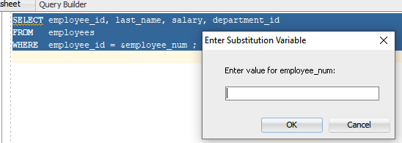
Using the & Substitution Variable
Use a variable prefixed with an ampersand (&) to prompt the user for a value:
SELECT employee_id, last_name, salary, department_id
FROM employees
WHERE employee_id = &employee_num ;

Slide 25
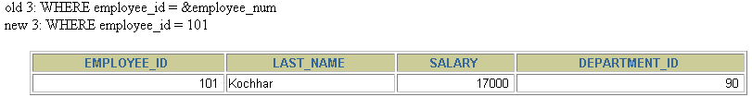
Using the & Substitution Variable
101

Slide 26
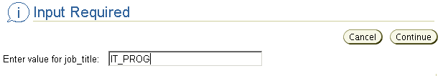
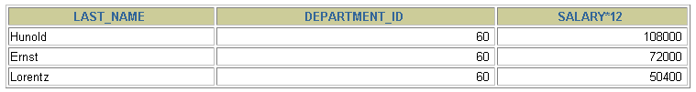
Character and Date Values with Substitution Variables
Use single quotation marks for date and character values:
SELECT last_name, department_id, salary*12
FROM employees
WHERE job_id = '&job_title' ;

Slide 27
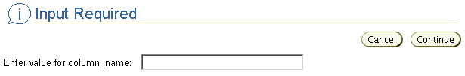
Specifying Column Names,
Expressions, and Text
SELECT employee_id, last_name, job_id,&column_name
FROM employees
WHERE &condition
ORDER BY &order_column ;
salary
salary > 15000
last_name

Slide 28
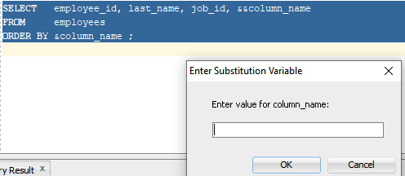
Using the && Substitution Variable
Use the double ampersand (&&) if you want to reuse the variable value without prompting the user each time:
SELECT employee_id, last_name, job_id, &&column_name
FROM employees
ORDER BY &column_name ;
…

Slide 29
Using the SQL Developer DEFINE Command
  Use the SQL Developer DEFINE command to create and assign a value to a variable.
  Use the SQL Developer UNDEFINE command to remove a variable.
DEFINE employee_num = 200
SELECT employee_id, last_name, salary, department_id
FROM employees
WHERE employee_id = &employee_num ;
UNDEFINE employee_num

Slide 30
Using the VERIFY Command
Use the VERIFY command to toggle the display of the substitution variable, both before and after SQL Developer replaces substitution variables with values:
SET VERIFY ON
SELECT employee_id, last_name, salary, department_id
FROM employees
WHERE employee_id = &employee_num;
old 3: WHERE employee_id = &employee_num
new 3: WHERE employee_id = 200

Slide 31
Summary
In this lesson, you should have learned how to:
  Use the WHERE clause to restrict rows of output:
    Use the comparison conditions
    Use the BETWEEN, IN, LIKE, and NULL conditions
    Apply the logical AND, OR, and NOT operators
  Use the ORDER BY clause to sort rows of output:
  Use ampersand substitution in SQL Developer to restrict and sort output at run time
SELECT *|{[DISTINCT] column|expression [alias],...}
FROM table
[WHERE condition(s)]
[ORDER BY {column, expr, alias} [ASC|DESC]] ;

Slide 32
Practice 2: Overview
This practice covers the following topics:
  Selecting data and changing the order of
  the rows that are displayed
  Restricting rows by using the WHERE clause
  Sorting rows by using the ORDER BY clause
  Using substitution variables to add flexibility to your SQL SELECT statements

